Slide 1
Rashtreeya Sikshana Samithi Trust
RV College of Engineering®, Bengaluru.
(An Autonomous Institution Affiliated to VTU, Belagavi)
UNIT 3
Data Distribution

Slide 2
Distributed Databases
In a distributed system, there are many, relatively autonomous processors that may participate in database operations.
In a distributed system, the processors are typically physically distant, rather than in the same room. The network connecting processors may have much less capacity than the network in a shared-nothing system.
Distributed databases offer significant advantages. Like parallel systems, a distributed system can use many processors and thereby accelerate the response to queries. Further, since the processors are widely separated, we can increase resilience in the face of failures by replicating data at several sites. On the other hand, distributed processing increases the complexity of every aspect of a database system, so we need to rethink how even the most basic components of a DBMS are designed. Since the cost of communicating may dominate the cost of processing in main memory, a critical issue is how many messages are sent between sites. In this section we shall introduce the principal issues, while the next sections concentrate on solutions to two important problems that come up in distributed databases: distributed commit and distributed
locking.

Slide 3
Distribution of Data : There are two situations Horizontal Decomposition and Vertical Partitioning.
Consider the example:
Sales(item, date, price, purchaser)
However, this relation does not exist physically. Rather, it is the union of a number of relations with the same schema, one at each of the stores in the chain. These local relations are called fragments, and the partitioning of a logical relation into physical fragments is called horizontal decomposition of the relation Sales.
A distributed database appears to have partitioned a relation “vertically,” by decomposing what might be one logical relation into two or more, each with a subset of the attributes, and with each relation at a different site.

Slide 4
Distributed Transactions
A consequence of the distribution of data is that a transaction may involve processes at several sites.
A transaction a piece of code executed by a single processor communicating with a single scheduler and a single log manager at a single site. Rather, a transaction consists of communicating transaction components, each at a different site and communicating with the local scheduler and logger.
Two important issues that must thus be looked at anew are:
1. How do we manage the commit/abort decision when a transaction is distributed?
W hat happens if one component of the transaction wants to abort the whole transaction, while others encountered no problem and want to commit?
2. How do we assure serializability of transactions that involve components at several sites? We look at locking , we see how local lock tables can be used to support global locks on database elements and thus support serializability of transactions in a distributed environment.

Slide 5
Data Replication
One motivation is that if a site fails, there may be other sites that can provide the same data that was at the failed site.
A second use is in improving the speed of query answering by making a copy of needed data available at the sites where queries are initiated.
There are several problems that must be faced when data is replicated.
a) How do we keep copies identical? In essence, an update to a replicated data element becomes
a distributed transaction that updates all copies.
b) How do we decide where and how many copies to keep? The more copies, the more effort is
required to update, but the easier queries become. For example, a relation that is rarely
updated might have copies everywhere for maximum efficiency, while a frequently updated
relation might have only one copy and a backup.
c) What happens when there is a communication failure in the network, and different copies of
the same data have the opportunity to evolve separately and must then be reconciled when
the network reconnects?

Slide 8
Chapter 25 Outline
Distributed Database Concepts
Data Fragmentation, Replication and Allocation
Types of Distributed Database Systems
Query Processing
Concurrency Control and Recovery
3-Tier Client-Server Architecture

Slide 9
Distributed Database Concepts
A transaction can be executed by multiple networked computers in a unified manner.
A distributed database (DDB) processes Unit of execution (a transaction) in a distributed manner. A distributed database (DDB) can be defined as
A distributed database (DDB) is a collection of multiple logically related database distributed over a computer network, and a distributed database management system as a software system that manages a distributed database while making the distribution transparent to the user.

Slide 10
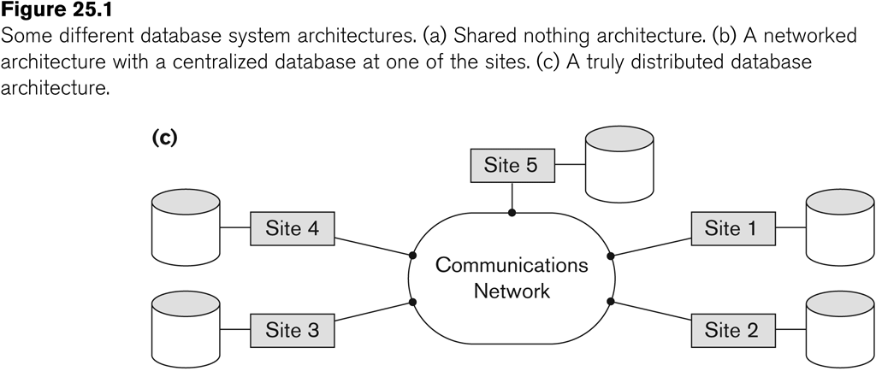
Distributed Database System
Advantages
Management of distributed data with different levels of transparency:
This refers to the physical placement of data (files, relations, etc.) which is not known to the user (distribution transparency).

Slide 11
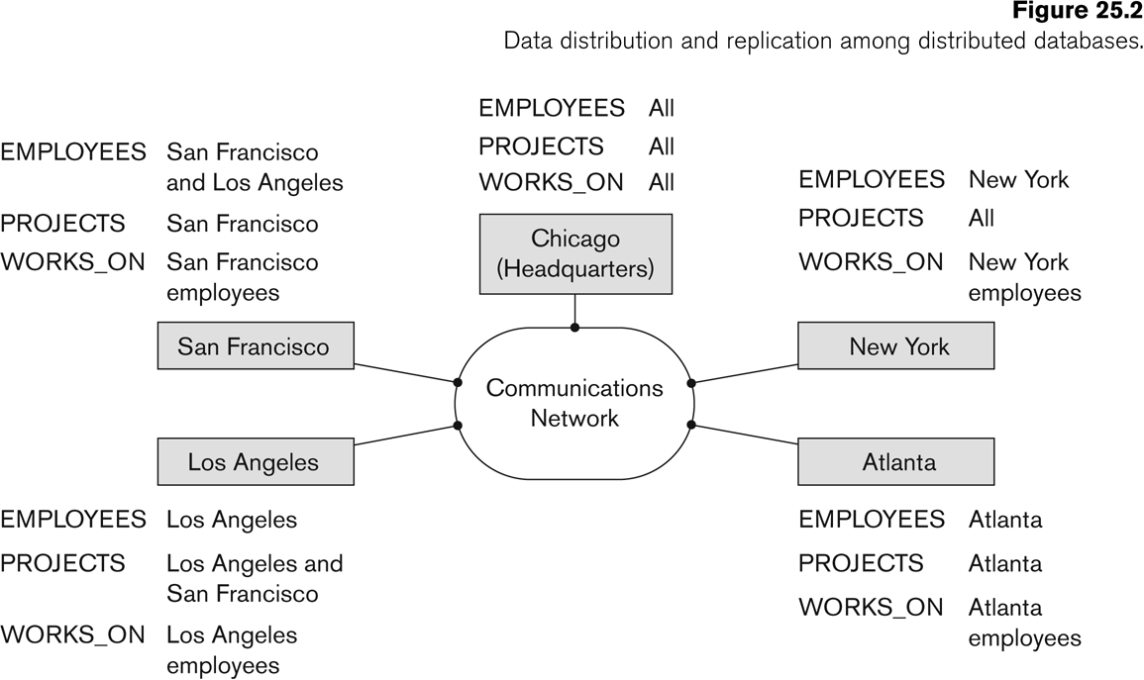
Distributed Database System
Advantages (transparency, contd.)
The EMPLOYEE, PROJECT, and WORKS_ON tables may be fragmented horizontally and stored with possible replication as shown below.

Slide 12
Distributed Database System
Advantages (transparency, contd.)
Distribution and Network transparency:
Users do not have to worry about operational details of the network.
There is Location transparency, which refers to freedom of issuing command from any location without affecting its working.
Then there is Naming transparency, which allows access to any names object (files, relations, etc.) from any location.

Slide 13
Distributed Database System
Advantages (transparency, contd.)
Replication transparency:
It allows to store copies of a data at multiple sites as shown in the above diagram.
This is done to minimize access time to the required data.
Fragmentation transparency:
Allows to fragment a relation horizontally (create a subset of tuples of a relation) or vertically (create a subset of columns of a relation).

Slide 14
Distributed Database System
Other Advantages
Increased reliability and availability:
Reliability refers to system live time, that is, system is running efficiently most of the time. Availability is the probability that the system is continuously available (usable or accessible) during a time interval.
A distributed database system has multiple nodes (computers) and if one fails then others are available to do the job.

Slide 15
Distributed Database System
Other Advantages (contd.)
Improved performance:
A distributed DBMS fragments the database to keep data closer to where it is needed most.
This reduces data management (access and modification) time significantly.
Easier expansion (scalability):
Allows new nodes (computers) to be added anytime without chaining the entire configuration.

Slide 16
Data Fragmentation, Replication and Allocation
Data Fragmentation
Split a relation into logically related and correct parts. A relation can be fragmented in two ways:
Horizontal Fragmentation
Vertical Fragmentation

Slide 17
Data Fragmentation, Replication and Allocation
Horizontal fragmentation
It is a horizontal subset of a relation which contain those of tuples which satisfy selection conditions.
Consider the Employee relation with selection condition (DNO = 5). All tuples satisfy this condition will create a subset which will be a horizontal fragment of Employee relation.
A selection condition may be composed of several conditions connected by AND or OR.
Derived horizontal fragmentation: It is the partitioning of a primary relation to other secondary relations which are related with Foreign keys.

Slide 18
Data Fragmentation, Replication and Allocation
Vertical fragmentation
It is a subset of a relation which is created by a subset of columns. Thus a vertical fragment of a relation will contain values of selected columns. There is no selection condition used in vertical fragmentation.
Consider the Employee relation. A vertical fragment of can be created by keeping the values of Name, Bdate, Sex, and Address.
Because there is no condition for creating a vertical fragment, each fragment must include the primary key attribute of the parent relation Employee. In this way all vertical fragments of a relation are connected.

Slide 19
Data Fragmentation, Replication and Allocation
Representation
Horizontal fragmentation
Each horizontal fragment on a relation can be specified by a σ_{Ci} (R) operation in the relational algebra.
Complete horizontal fragmentation
A set of horizontal fragments whose conditions C1, C2, …, Cn include all the tuples in R- that is, every tuple in R satisfies (C1 OR C2 OR … OR Cn).
Disjoint complete horizontal fragmentation: No tuple in R satisfies (Ci AND Cj) where i ≠ j.
To reconstruct R from horizontal fragments a UNION is applied.

Slide 20
Data Fragmentation, Replication and Allocation
Representation
Vertical fragmentation
A vertical fragment on a relation can be specified by a Π_{Li}(R) operation in the relational algebra.
Complete vertical fragmentation
A set of vertical fragments whose projection lists L1, L2, …, Ln include all the attributes in R but share only the primary key of R. In this case the projection lists satisfy the following two conditions:
L1 ∪ L2 ∪ ... ∪ Ln = ATTRS (R)
Li ∩ Lj = PK(R) for any i j, where ATTRS (R) is the set of attributes of R and PK(R) is the primary key of R.
To reconstruct R from complete vertical fragments a OUTER UNION is applied.

Slide 21
Data Fragmentation, Replication and Allocation
Representation
Mixed (Hybrid) fragmentation
A combination of Vertical fragmentation and Horizontal fragmentation.
This is achieved by SELECT-PROJECT operations which is represented by Π_{Li}(σ_{Ci} (R)).
If C = True (Select all tuples) and L ≠ ATTRS(R), we get a vertical fragment, and if C ≠ True and L ≠ ATTRS(R), we get a mixed fragment.
If C = True and L = ATTRS(R), then R can be considered a fragment.

Slide 22
Data Fragmentation, Replication and Allocation
Fragmentation schema
A definition of a set of fragments (horizontal or vertical or horizontal and vertical) that includes all attributes and tuples in the database that satisfies the condition that the whole database can be reconstructed from the fragments by applying some sequence of UNION (or OUTER JOIN) and UNION operations.
Allocation schema
It describes the distribution of fragments to sites of distributed databases. It can be fully or partially replicated or can be partitioned.

Slide 23
Data Fragmentation, Replication and Allocation
Data Replication
Database is replicated to all sites.
In full replication the entire database is replicated and in partial replication some selected part is replicated to some of the sites.
Data replication is achieved through a replication schema.
Data Distribution (Data Allocation)
This is relevant only in the case of partial replication or partition.
The selected portion of the database is distributed to the database sites.

Slide 24
Types of Distributed Database Systems
Homogeneous
All sites of the database system have identical setup, i.e., same database system software.
The underlying operating system may be different.
For example, all sites run Oracle or DB2, or Sybase or some other database system.
The underlying operating systems can be a mixture of Linux, Window, Unix, etc.

Slide 25
Types of Distributed Database Systems
Heterogeneous
Federated: Each site may run different database system but the data access is managed through a single conceptual schema.
This implies that the degree of local autonomy is minimum. Each site must adhere to a centralized access policy. There may be a global schema.
Multidatabase: There is no one conceptual global schema. For data access a schema is constructed dynamically as needed by the application software.

Slide 26
Types of Distributed Database Systems
Federated Database Management Systems Issues
Differences in data models:
Relational, Objected oriented, hierarchical, network, etc.
Differences in constraints:
Each site may have their own data accessing and processing constraints.
Differences in query language:
Some site may use SQL, some may use SQL-89, some may use SQL-92, and so on.

Slide 27
Query Processing in Distributed Databases
Issues
Cost of transferring data (files and results) over the network.
This cost is usually high so some optimization is necessary.
Example relations: Employee at site 1 and Department at Site 2
Employee at site 1. 10,000 rows. Row size = 100 bytes. Table size = 10⁶ bytes.
Department at Site 2. 100 rows. Row size = 35 bytes. Table size = 3,500 bytes.
Q: For each employee, retrieve employee name and department name Where the employee works.
Q: Π_{Fname,Lname,Dname} (Employee _{Dno = Dnumber} Department)
Fname | Minit | Lname | SSN | Bdate | Address | Sex | Salary | Superssn | Dno
Dname | Dnumber | Mgrssn | Mgrstartdate

Slide 28
Query Processing in Distributed Databases
Result
The result of this query will have 10,000 tuples, assuming that every employee is related to a department.
Suppose each result tuple is 40 bytes long. The query is submitted at site 3 and the result is sent to this site.
Problem: Employee and Department relations are not present at site 3.

Slide 29
Query Processing in Distributed Databases
Strategies:
Transfer Employee and Department to site 3.
Total transfer bytes = 1,000,000 + 3500 = 1,003,500 bytes.
Transfer Employee to site 2, execute join at site 2 and send the result to site 3.
Query result size = 40 * 10,000 = 400,000 bytes. Total transfer size = 400,000 + 1,000,000 = 1,400,000 bytes.
Transfer Department relation to site 1, execute the join at site 1, and send the result to site 3.
Total bytes transferred = 400,000 + 3500 = 403,500 bytes.
Optimization criteria: minimizing data transfer.

Slide 30
Query Processing in Distributed Databases
Strategies:
Transfer Employee and Department to site 3.
Total transfer bytes = 1,000,000 + 3500 = 1,003,500 bytes.
Transfer Employee to site 2, execute join at site 2 and send the result to site 3.
Query result size = 40 * 10,000 = 400,000 bytes. Total transfer size = 400,000 + 1,000,000 = 1,400,000 bytes.
Transfer Department relation to site 1, execute the join at site 1, and send the result to site 3.
Total bytes transferred = 400,000 + 3500 = 403,500 bytes.
Optimization criteria: minimizing data transfer.
Preferred approach: strategy 3.

Slide 31
Query Processing in Distributed Databases
Consider the query
Q’: For each department, retrieve the department name and the name of the department manager
Relational Algebra expression:
Π_{Fname,Lname,Dname} (Employee _{Mgrssn = SSN} Department)

Slide 32
Query Processing in Distributed Databases
The result of this query will have 100 tuples, assuming that every department has a manager, the execution strategies are:
Transfer Employee and Department to the result site and perform the join at site 3.
Total bytes transferred = 1,000,000 + 3500 = 1,003,500 bytes.
Transfer Employee to site 2, execute join at site 2 and send the result to site 3. Query result size = 40 * 100 = 4000 bytes.
Total transfer size = 4000 + 1,000,000 = 1,004,000 bytes.
Transfer Department relation to site 1, execute join at site 1 and send the result to site 3.
Total transfer size = 4000 + 3500 = 7500 bytes.

Slide 33
Query Processing in Distributed Databases
The result of this query will have 100 tuples, assuming that every department has a manager, the execution strategies are:
Transfer Employee and Department to the result site and perform the join at site 3.
Total bytes transferred = 1,000,000 + 3500 = 1,003,500 bytes.
Transfer Employee to site 2, execute join at site 2 and send the result to site 3. Query result size = 40 * 100 = 4000 bytes.
Total transfer size = 4000 + 1,000,000 = 1,004,000 bytes.
Transfer Department relation to site 1, execute join at site 1 and send the result to site 3.
Total transfer size = 4000 + 3500 = 7500 bytes.
Preferred strategy: Choose strategy 3.

Slide 34
Query Processing in Distributed Databases
Now suppose the result site is 2. Possible strategies :
Transfer Employee relation to site 2, execute the query and present the result to the user at site 2.
Total transfer size = 1,000,000 bytes for both queries Q and Q’.
Transfer Department relation to site 1, execute join at site 1 and send the result back to site 2.
Total transfer size for Q = 400,000 + 3500 = 403,500 bytes and for Q’ = 4000 + 3500 = 7500 bytes.

Slide 35
Query Processing in Distributed Databases
Semijoin:
Objective is to reduce the number of tuples in a relation before transferring it to another site.
Example execution of Q or Q’:
Project the join attributes of Department at site 2, and transfer them to site 1. For Q, 4 * 100 = 400 bytes are transferred and for Q’, 9 * 100 = 900 bytes are transferred.
Join the transferred file with the Employee relation at site 1, and transfer the required attributes from the resulting file to site 2. For Q, 34 * 10,000 = 340,000 bytes are transferred and for Q’, 39 * 100 = 3900 bytes are transferred.
Execute the query by joining the transferred file with Department and present the result to the user at site 2.

